Slide 1
3D Print Shop
Lisa Over
CMPINF 2110 April 2, 2021

Slide 2
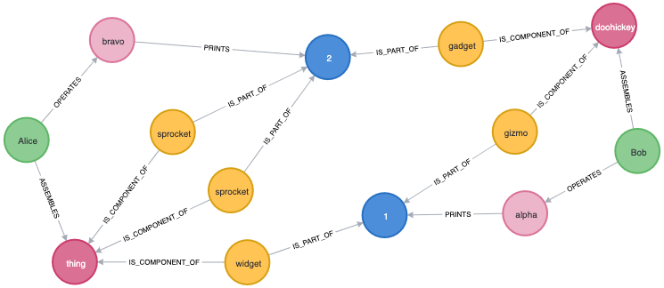
Query of All Nodes: MATCH (n) RETURN n

Slide 3
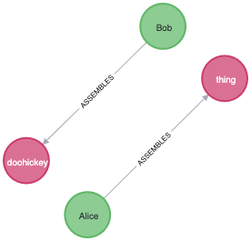
Query of Relationships Between Employees and Devices: MATCH (e:Employees)-[]-(d:Devices) RETURN e,d

Slide 4
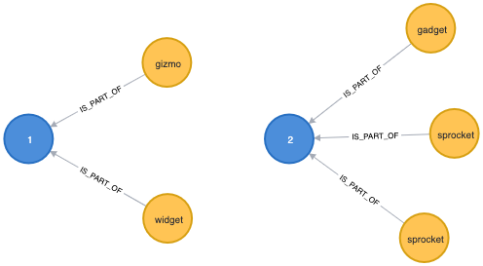
Query of Relationships Between Employees and Devices: MATCH (p:Parts)-[]-(j:Jobs) RETURN p,j

